Slide 1


Can Data predict the Mega Millions or is it a Mega Trap?
A statistical exploration of the winners and the winning numbers from 2002 – 2021
Alberta "Albi" Kovatcheva & Barbra Treston

Slide 2
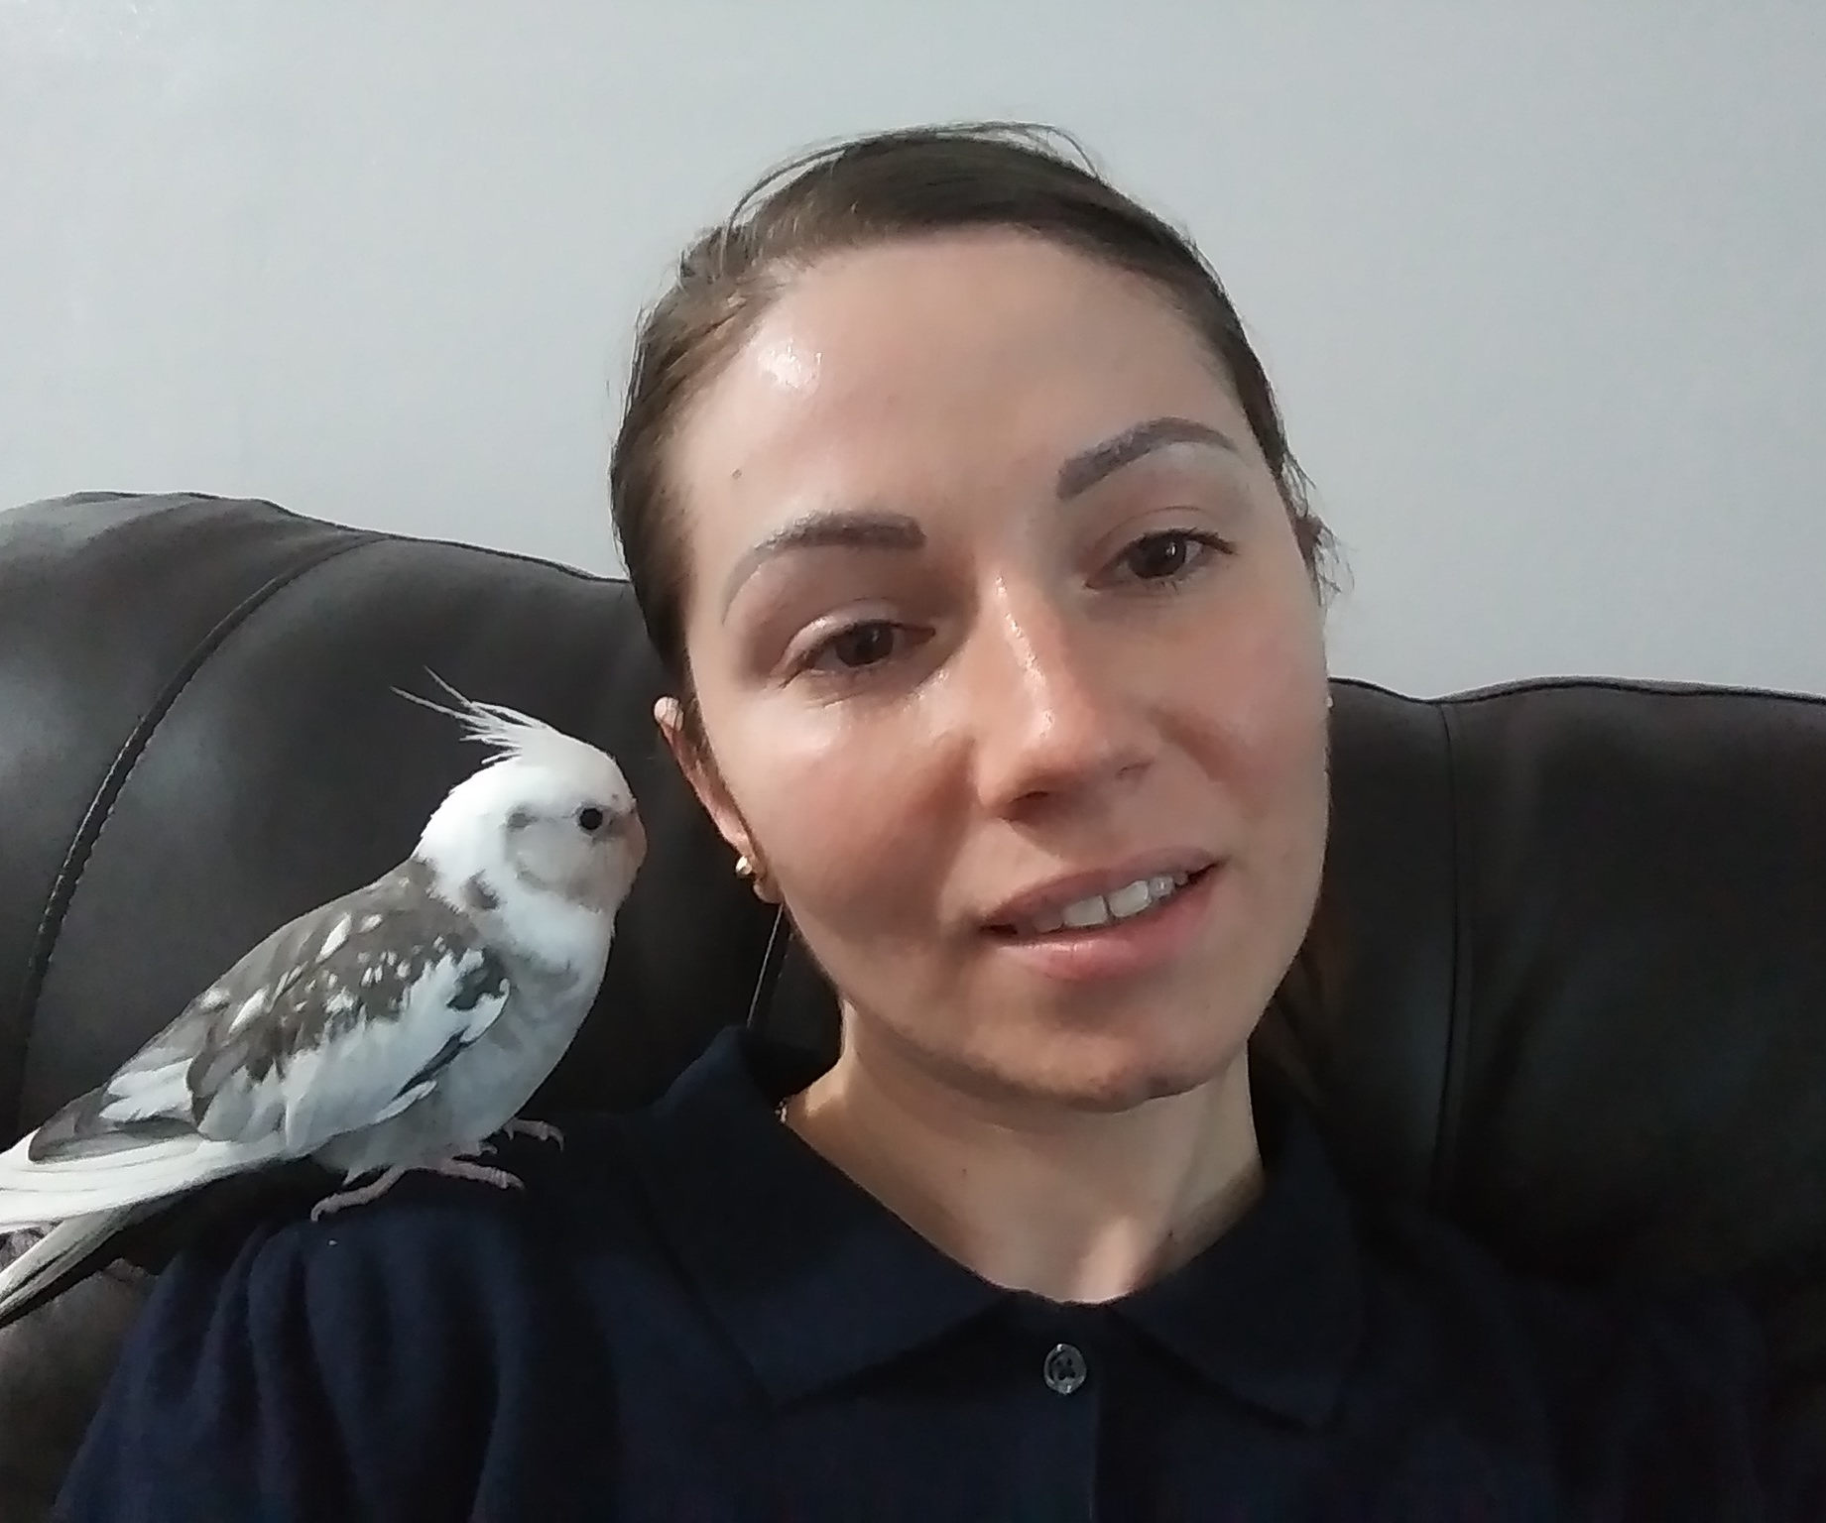
EDUCATION:
ENTITY Academy: 2020 - PRESENT
New York University: MS Mechanical Engineering 2019
Employment:
NJ Dept. Of Environmental Protection:
Case Manager | 2020 - PRESENT
Con Edison:
Supervisor | 2019 - 2020
Area of Expertise:
Energy Industry
Why Data Science?
To learn about the world using data analytics
Alberta
"Albi"
Kovatcheva

Slide 3

EDUCATION:
ENTITY Academy: 2020 - PRESENT
City College Of NY: MA Mental Health Counseling
Employment:
A-1 Universal Care, Inc:
Director of Self-directed Services | 2019 - PRESENT
Support Broker | 2018 - PRESENT
Medicaid Service Coordinator/Care Manager | 2017 - 2018
Area of Expertise:
Psychology, Behavioral Health, Social Service
Why Data Science?
To improve mental health care by deepening research
and directing resources where they will be most effective
Barbra
Treston

Slide 4
It all Started with a Plan Get Rich Quick ….
Who hasn’t dreamed of hitting the jackpot and changing their life forever?
Many people try every day. However, almost no one expects to win

Slide 5
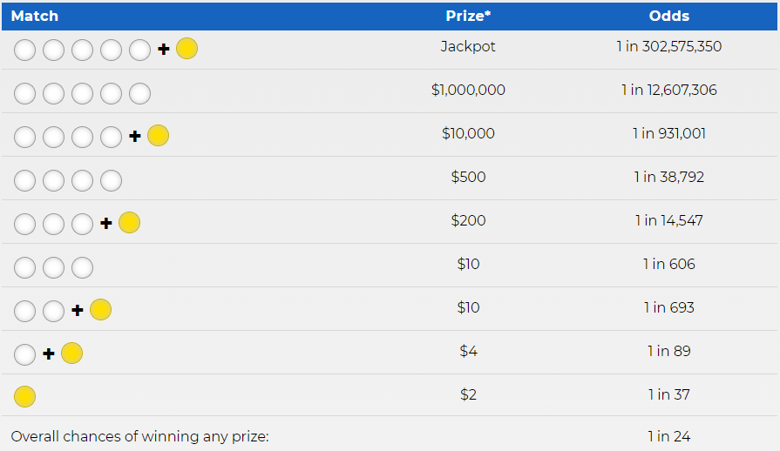
What are the odds?
The numbers are chosen by
random number generator [5].
To win the jackpot, players
must choose a 6 numbers
correctly:
  5 numbers between
  1 and 70 (the white balls)
  1 number between
  1 and 25 (the gold Mega Ball)
There is a 1 in 24 chance of winning something.
BUT the odds of winning the jackpot is 1 in 302,575,350.

Slide 6
How does it work?
Massive consistent income from ticket sales (more than $9 billion a year in New York state) [5].
Organizers set the prize amounts, not near reflective of the probability of winning the prize.
Profits subsidize basic public programs.
Can also exacerbate socioeconomic inequality [1-4].
  Approximately 70% of lottery winners end up going broke.
  Winners of $50k or more have increased risk of filing bankruptcy within 5 years.
Scams happen.
  Hot Lotto Scandal [6].
  Nefarious entities.

Slide 7
The Data
Data.ny.gov: ‘Lottery Mega Millions Winning Numbers (2002-2021)’: 2036 entries.
Megamillions.com: ‘Jackpot Winners ’: 224 entries.
‘NonJackpot winners’: 265 entries.
The Questions
Can machine learning predict lottery outcomes to ensure player ROI?
Does gender impact prize amount or likelihood of winning?
Data Collection and Wrangling Strategies
Wrangled/recoded the data to extract month, day, year, weekday, & quarter from 'Draw Date’.
Scraped megamillions.com for data on Jackpot winners and Non-jackpot winners.
Merge Winning Numbers Data with Winner Data by 'Draw Date’.
Languages &Tools
Python 3.10.0 & R 4.1.2.
Jupyter Notebook, Visual Studio Code, Tableau, & Github.
’

Slide 8
A Look At The Data
Summary Statistics and data exploration

Slide 9
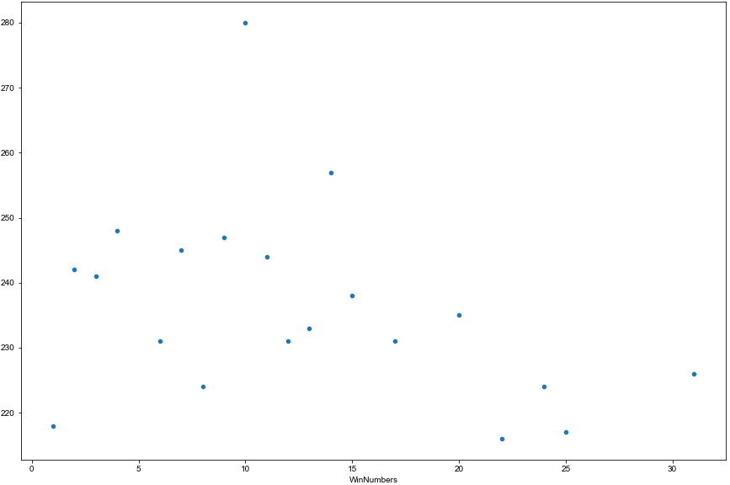
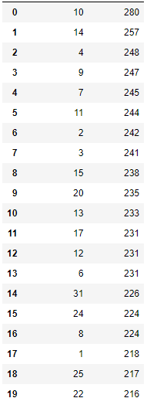
Frequency of Winning Number Occurrence (2002 – 2021)
Winning Numbers Frequency
Frequency of Occurrence
Winning Numbers

Slide 10
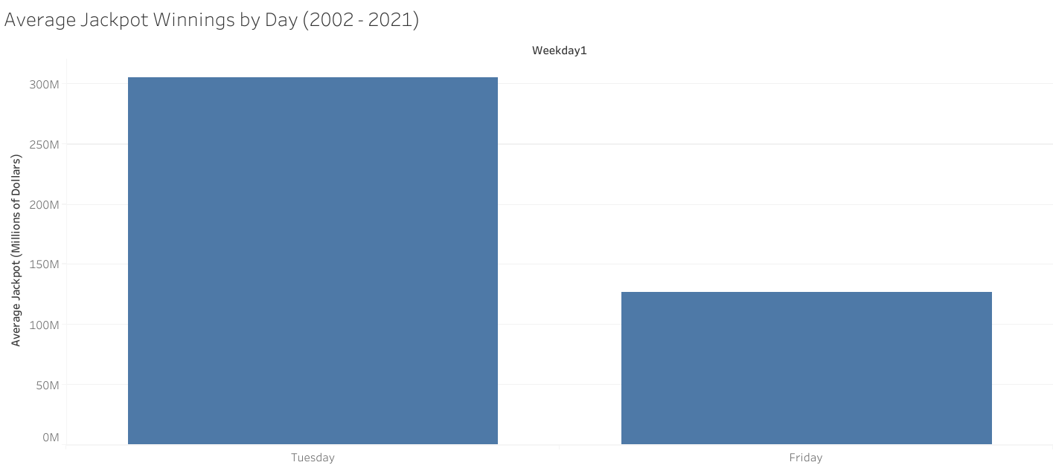

Slide 11
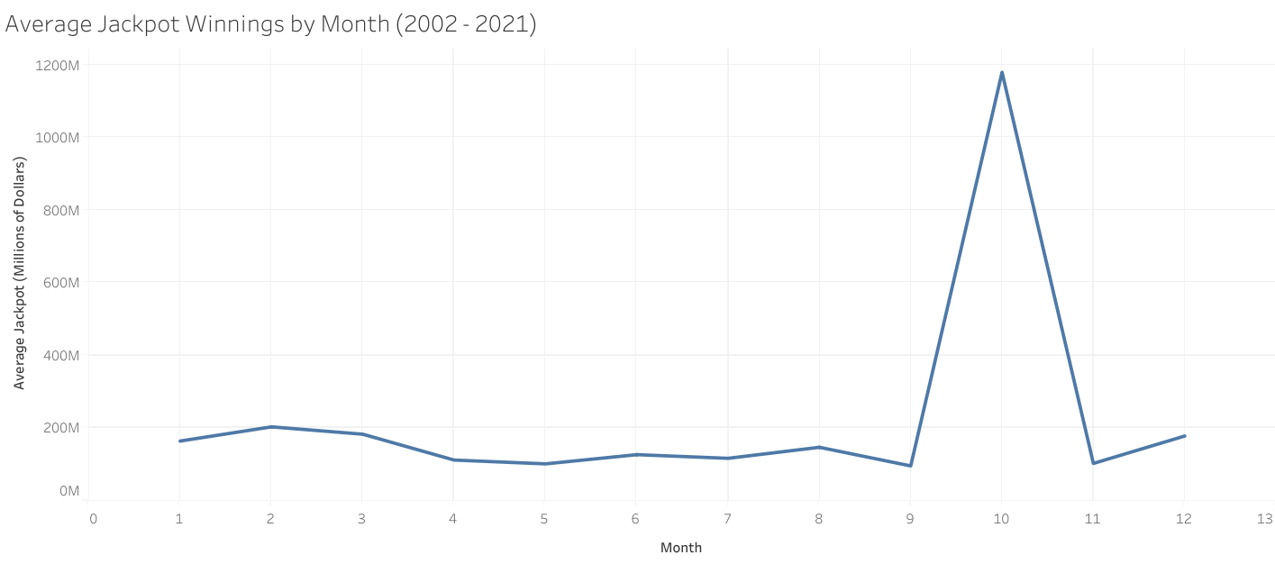

Slide 12
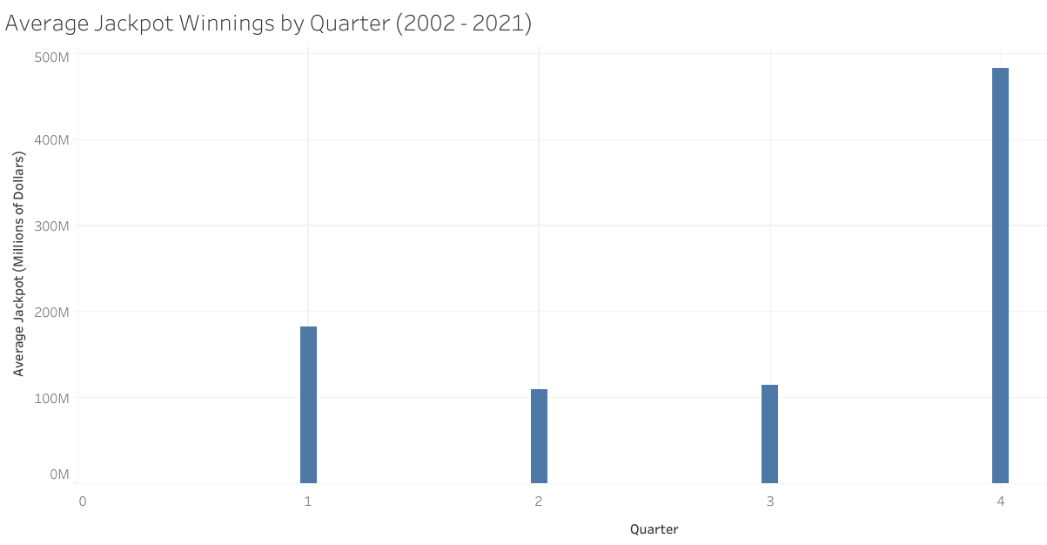

Slide 13
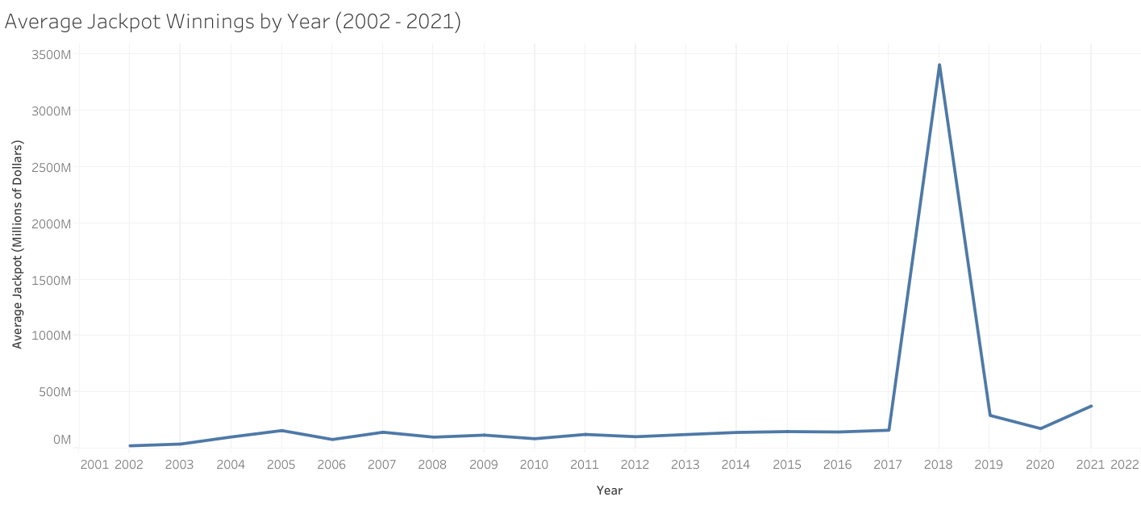

Slide 14
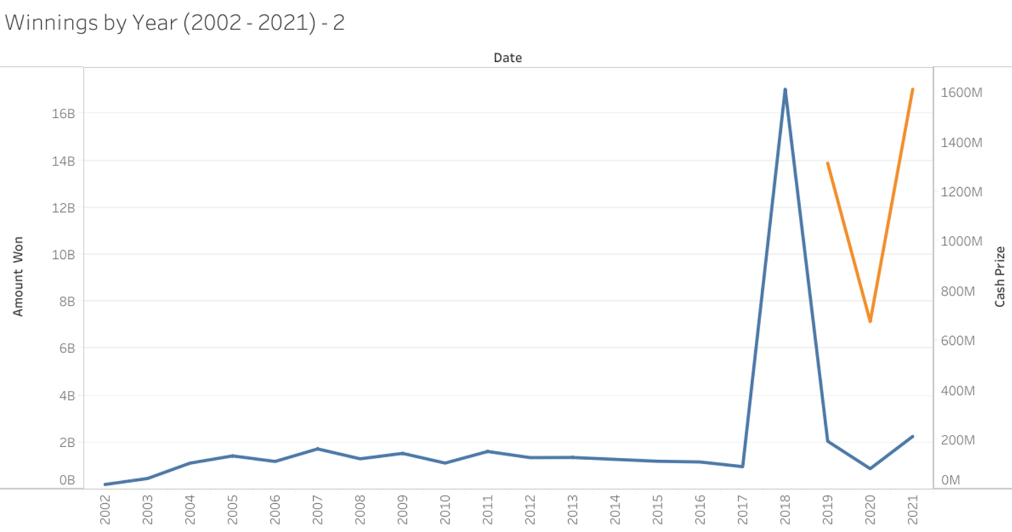
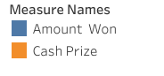

Slide 15
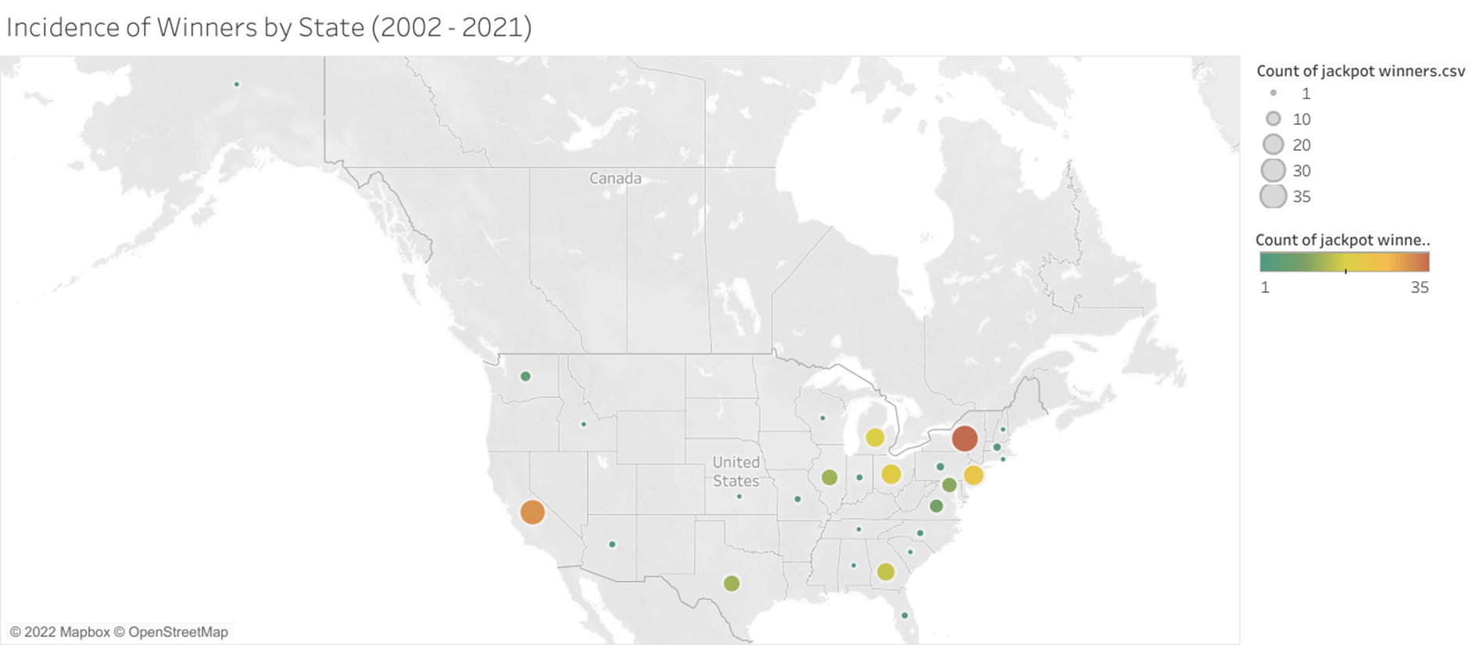


Slide 16
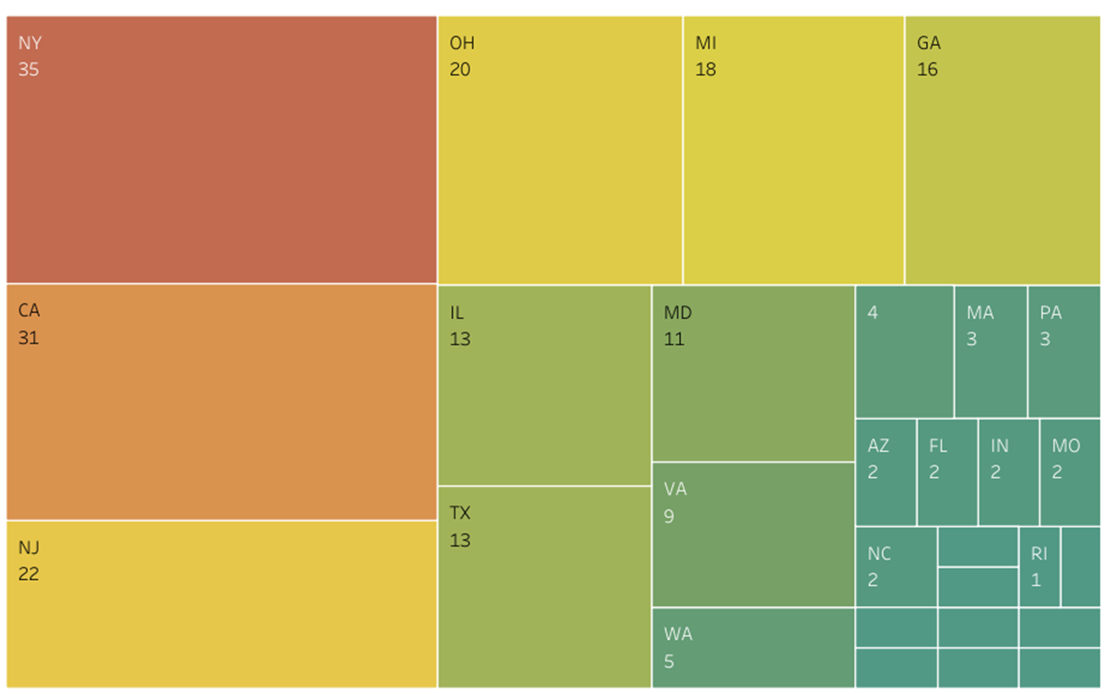


Slide 17
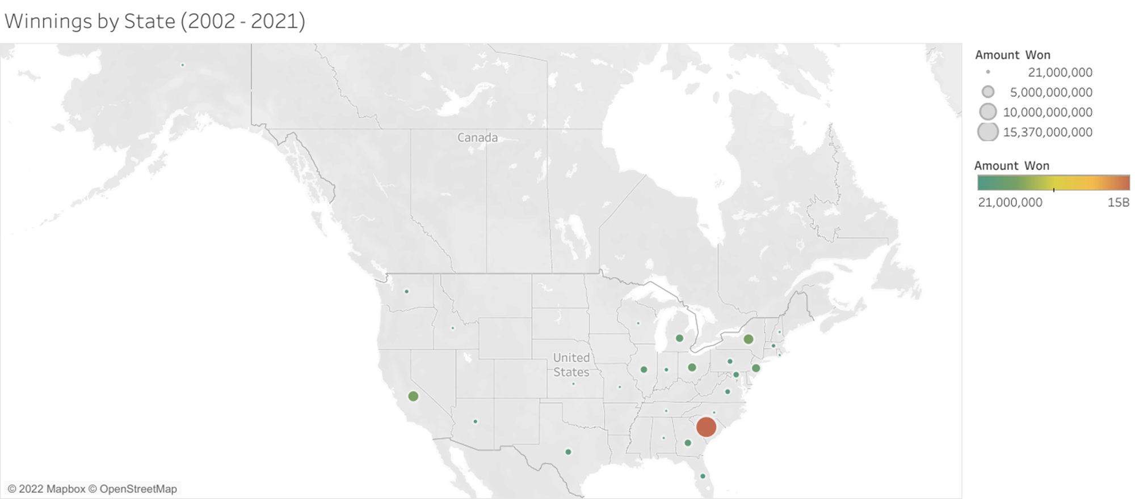
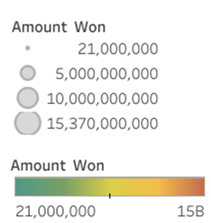

Slide 18
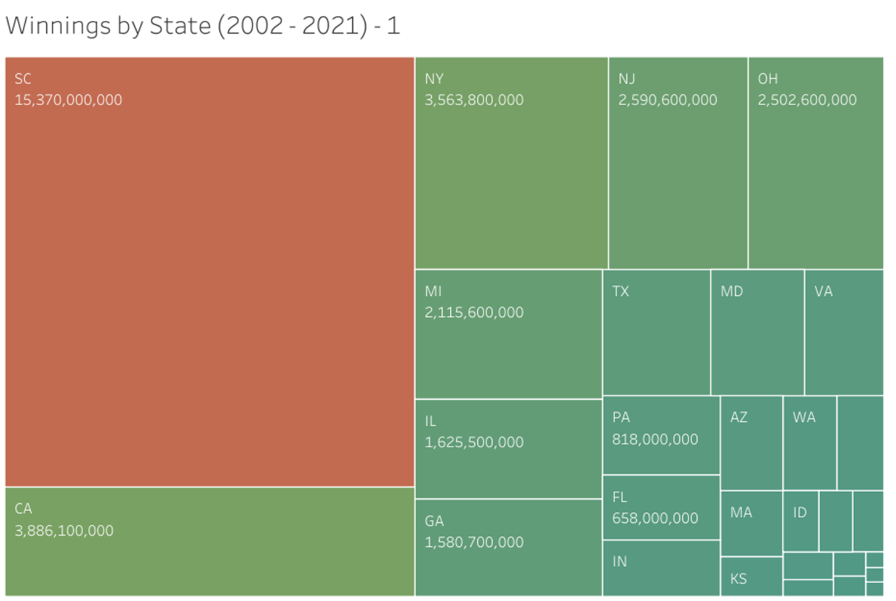


Slide 19
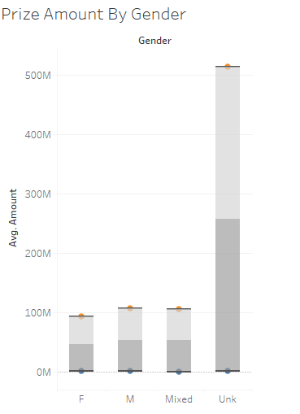
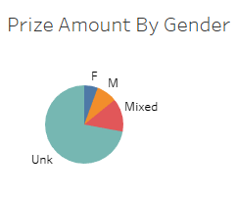
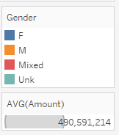

Slide 20
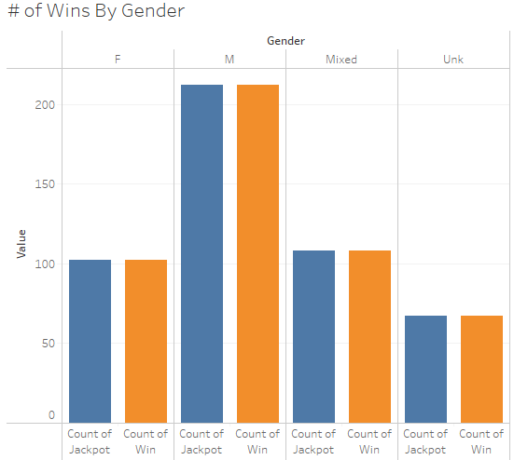

Slide 21
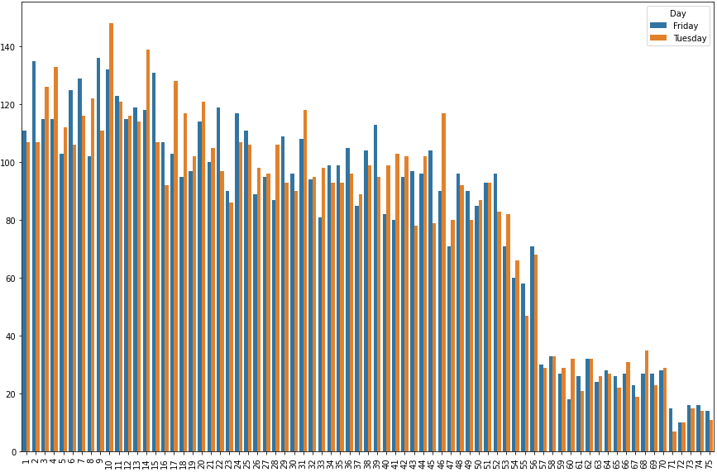
Winning Number Frequencies by Day of the Week (2002 - 202)
Frequency of Occurrence
Winning Numbers

Slide 22
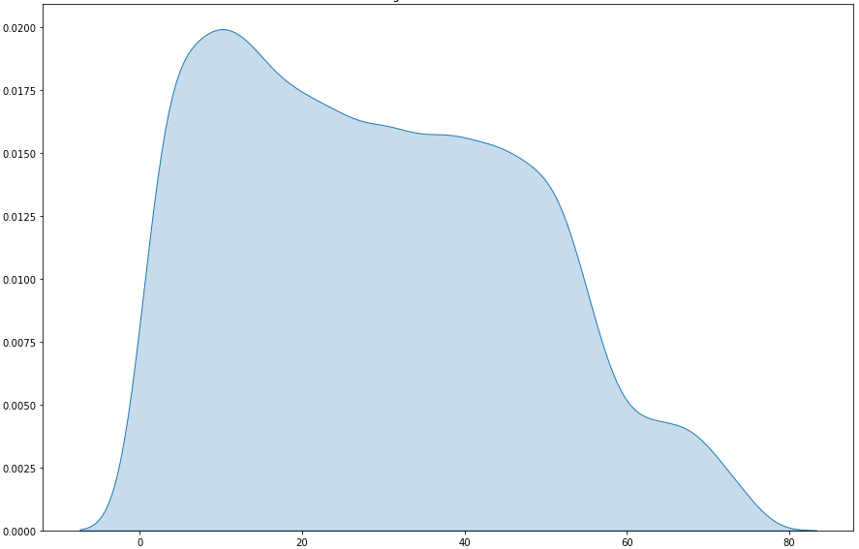
Winning Numbers Kernel Density Estimation (KDE) Plot
KDE plot shape is highly similar for month, day, year, etc.
Probability Density Function (PDF) Estimate
Winning Numbers

Slide 23
What the Analysis Shows
Results

Slide 24
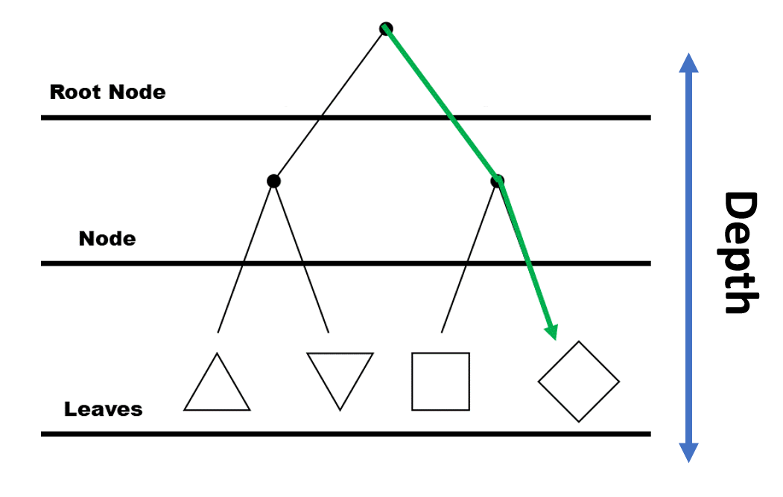
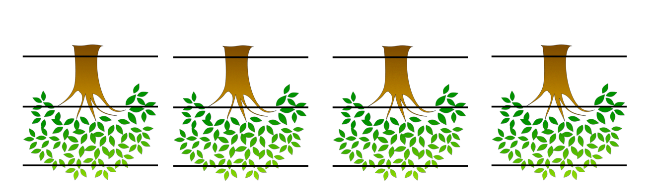
Can machine learning predict lottery outcomes to ensure player ROI?
What is machine learning?
Decision trees vs. random forests.
Classifier vs. regressor.
Maximum Depth
Number of Estimators

Slide 25
Predictors and response variables:
Predictors:
Month
Day
Year
Day of the Week
Quarter
Response:
Winning Numbers.
Parameters used for Random forest
classifier model:
500 estimators
2 Minimum number of samples
for a leaf
‘auto’ Maximum number
of features
20 Maximum depth
Maximum Depth
Number of Estimators

Slide 26
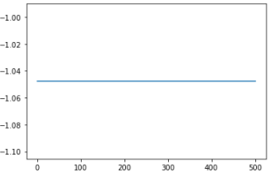
Can machine learning predict lottery outcomes to ensure play ROI?
Model accuracy is approx. 1%.
Flat curve.
Accuracy ≥ 80% is considered ‘good’
Machine learning ends at accuracy levels
50% or below.
What this means about the data.
Applications of Machine Learning.
Random Forest Model Effectiveness
Results
Number of Estimators

Slide 27
Feature Importance
Day of the month seems to have the most influence on winning lottery numbers.
Accuracy is still approximately 1%.
Assessment of Feature Importance
Quarter
Day of the Week
Month
Year
Day
Feature Importance

Slide 28
Does Gender impact prize amount?
Short answer? No
Even when controlling for Jackpot VS. Non-Jackpot prize, there is no statistical difference in jackpot size by gender
Excluding Mixed Gender groups and winners whose gender was unknown did not change this result

Slide 29
Does Gender impact the likelihood of winning?
Yes
Fewer Women were Jackpot Winners than expected
While more Mixed Gender Groups and winners whose gender was unknown were Jackpot Winners than expected.
Men won Jackpots as often as expected

Slide 30
What does this mean for the player?
Summary and Conclusions

Slide 31
Jackpot Winnings: Min: $7.5 M; Max: $15 B; Average: $185 M.
Non-Jackpot Winnings: Min: $17.9 M; Max: $766 M; Average: $200.1 M.
Time of year was not a significant predictor to lottery numbers.
Prize Amount did not vary significantly according to gender, but likelihood of winning did vary by gender.

Slide 32
Statistical methods cannot accurately predict lottery outcomes. Instead, they can show that is lottery “fair.”
Lotteries companies should use statistical methods to continuously assess lottery fairness.
Opportunity in life is often not evenly distributed. Let’s create our own instead!
Question for audience: What Is the role of the lottery in modern Society?

Slide 33
Questions ?

Slide 34
[1] C. Hemmings, “Why are most problem gamblers men?,” BBC News, 13-Feb-2018. [Online]. Available: https://www.bbc.com/news/uk-43002380. [Accessed: 15-Jan-2022].
[2] D.-M. Griswold, “Gambling addiction facts and statistics: The recovery village,” The Recovery Village Drug and Alcohol Rehab, 19-Nov-2020. [Online]. Available: https://www.therecoveryvillage.com/process-addiction/compulsive-gambling/related/gambling-statistics/. [Accessed: 15-Jan-2022].
[3] “Gambling Facts &amp; Stats | easy money | frontline,” PBS. [Online]. Available: https://www.pbs.org/wgbh/pages/frontline/shows/gamble/etc/facts.html. [Accessed: 15-Jan-2022].

Slide 35
[4] “Gambling statistics,” Play It Safe, 24-Jun-2013. [Online]. Available: https://playitsafeohio.org/safe-gambling-tips/facts-figures/#:~:text=National%20Gambling%20Statistics&amp;text=Approximately%2085%20percent%20of%20Americans,gambled%20in%20the%20previous%20year.&amp;text=In%202010%2C%20approximately%2025%20percent,in%20the%20past%2012%20months. [Accessed: 15-Jan-2022].
[5] “How to play,” Mega Millions. [Online]. Available: https://www.megamillions.com/How-to-Play.aspx. [Accessed: 15-Jan-2022].
[6] T. Fish, “MAN fighting jail sentence for rigging lottery so he won 3 times a year,” Newsweek, 12-Nov-2021. [Online]. Available: https://www.newsweek.com/eddie-tipton-lottery-scammer-fixing-guilty-plea-1648602. [Accessed: 15-Jan-2022].

